Slide 1
Introduction to Transaction Memory

Slide 2

Content
Multiple-thread programming
Synchronization issues
Lock based synchronization
Transaction memory

Slide 3
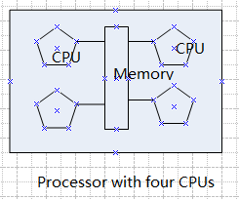
Multiple-thread programming
A chip has more CPUs rather then a faster CPU, so as to facilitate the chip we must learn to write parallel programs.
We need a new programming model

Slide 4
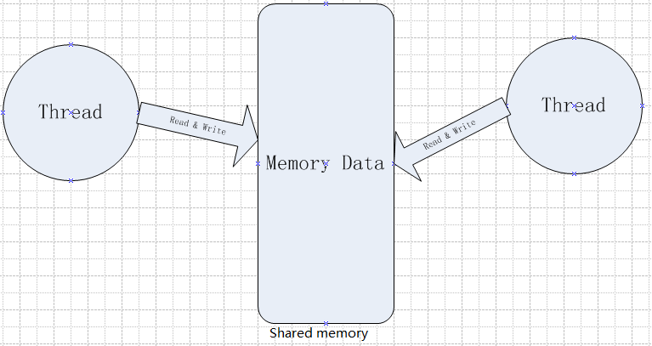
Multiple-access to the data
Multiple threads may operate the same data or use the shared memory.

Slide 5
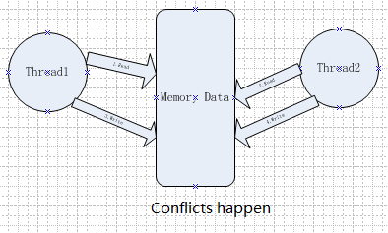
Conflicts happen
When threads read & write the data, not in a particular order, conflicts happen
int money;
void Thread1()
{
int count1 = money; count1 + = 10;
money = count1;
}
void Thread2()
{
int count2 = money;
count2 -=10;
money = count2;
}

Slide 6
Synchronization issues
We call the conflicts synchronization problems with the parallel programming. And in database we also encounter this issue.
Do you still remember the database classes

Slide 7
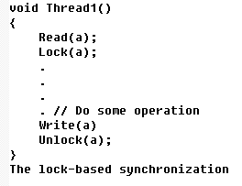
Conventional approach
Lock based synchronization is the conventional approach to solve the problem above.
Example:

Slide 8
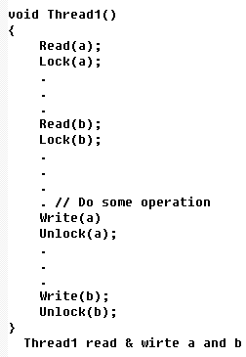
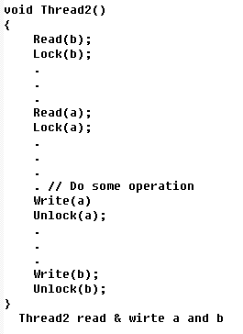
Drawbacks of conventional approach
Dead lock

Slide 9
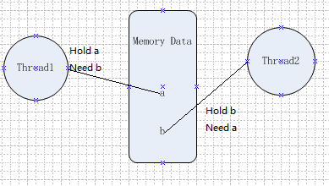
Deadlock
Thread 1 and thread 2 are in deadlock state

Slide 10
Disadvantages of Lock system
Livelock
Data consistency
A real-world example of livelock occurs when two people meet in a narrow corridor, and each tries to be polite by moving aside to let the other pass, but they end up swaying from side to side without making any progress because they both repeatedly move the same way at the same time.

Slide 11
Disadvantages of Lock system
Priority-inversion
Lock placement
A phenomenon where a high-priority thread is forced to wait on a low-priority thread holding exclusive access to a resource that it needs.
If using several locks, how to manage them?

Slide 12
STM
Software Transaction memory
A thread completes modifications to shared memory without regard for what other threads might be doing, recording every read and write that it is performing in a log.

Slide 13
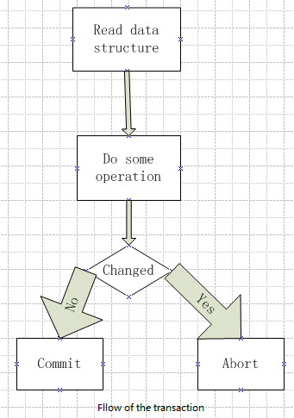
Implementation of STM
We use commit - abort mechanism

Slide 14
Implementation of STM
Optimistic reads:
Private revocable writes:
Every time we read an object, we remember is version. When commit the transaction, we verify that the version for every object we read is still the same as it was when we read it.
Whenever we want to write to a object, we first lock it. Next, we make a private copy of the object. Any changes we want to make we make to this private copy. Finally, we atomically swap out the old copy, say it commit.

Slide 15
Implementation of STM
Deadlock detection.
Since we using lock here, dead lock is sure to happen sooner or later.
We periodically interrupt the program and scan for a cycle of objects that deadlocked.

Slide 16
Thank you！

